Slide 1

Resume-Analyzer‑ATS‑Score‑Predictor: Engineering Internship Project Overview
This project is an AI-driven platform that predicts Applicant Tracking System (ATS) compatibility and provides actionable guidance to improve resumes for engineering internships. It blends resume parsing, NLP-driven keyword matching, and a transparent scoring model to help candidates increase their interview chances. The design emphasises clarity, data-backed feedback, and a user-first interface tailored to the Indian job market.

Slide 2




Introduction: The Challenge of Modern Job Applications
Why ATS Matters
Candidate Pain Points
Recruiter Workflow
Over 75% of resumes never reach human recruiters due to automated filtering. ATS evaluates keywords, formatting, and relevance — often eliminating qualified candidates for small formatting issues.
Candidates struggle to know which keywords to prioritise and how to format resumes for machine parsing. A clear, automated guide reduces guesswork and boosts confidence.
Recruiters need faster pre-screening without sacrificing quality. Smart tooling improves match rates and speeds up hiring cycles.

Slide 3



What is Resume-Analyzer‑ATS‑Score‑Predictor?
The Resume-Analyzer is an AI-powered assistant that predicts an ATS compatibility score (0–100) and offers targeted recommendations. It ingests resumes and job descriptions, extracts meaningful entities (skills, roles, education), identifies gaps, and proposes edits that increase keyword alignment and readability for parsers.
Predictive scoring with explainable features
Actionable, prioritised suggestions
Support for DOCX, PDF, and TXT uploads
Focus: practical, explainable, and developer-friendly for internship-level contribution.

Slide 4






Core Features and Functionalities
Multi-format Upload
Keyword & Gap Analysis
Upload DOCX, PDF or TXT. Parser normalises layout and extracts structured sections (summary, experience, education, skills).
NLP-powered comparison against job descriptions highlights missing or underrepresented keywords and suggests contextual replacements.
ATS Compatibility Score
Exportable Reports
Score on a 0–100 scale with breakdown by Keyword Coverage, Position Alignment and Formatting Quality.
Download tailored reports and suggested resume drafts to iterate rapidly for each job application.

Slide 5


Technical Architecture and Tools Used
Built as a modular, open-source stack to encourage contributions. Core components include:
Backend: Python with spaCy and NLTK for parsing and entity extraction
Machine Learning: Classification and regression models for scoring and prediction
Frontend: React.js for responsive UI and instant feedback
Integrations: Resume parsing APIs and standard ATS schemas
Design emphasises reproducibility: containerised services, clear data schemas, and test datasets to validate scoring across Indian job categories.

Slide 6
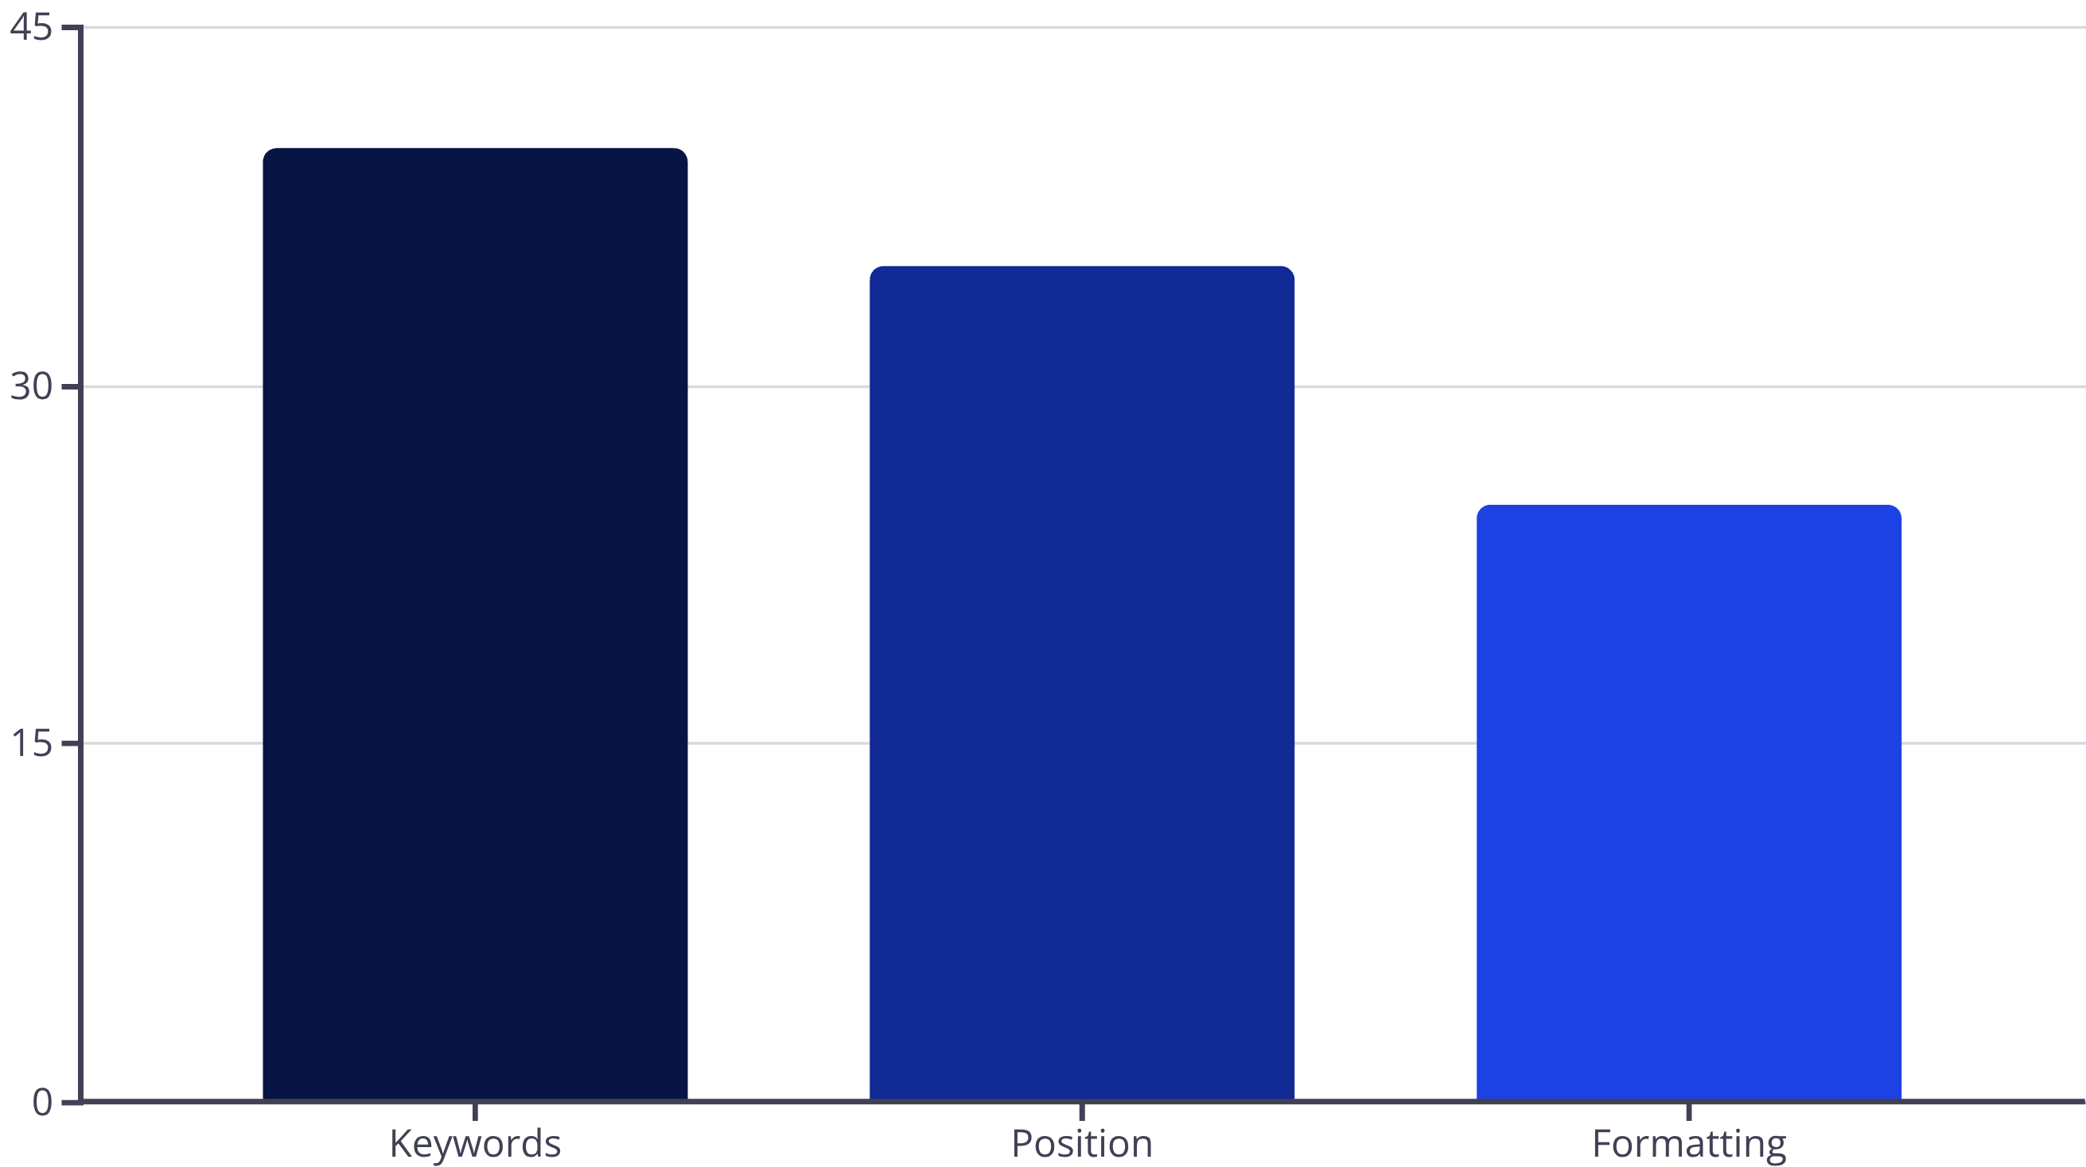

Data-Driven Insights Behind ATS Scoring
The scoring model weights keyword coverage most heavily, followed by role alignment and formatting quality. Emphasis on measurable achievements (metrics, results) significantly improves scores. Common pitfalls include non-standard section headers, images in resume body, and inconsistent date formats.

Slide 7

Competitive Landscape and Differentiators
Open-source Transparency
Customisable Scoring
India-focused Nuances
Score weights and keyword ontologies can be tuned for different industries and academic levels.
Recognises local resume conventions, education formats and common role titles used in the Indian job market.
Unlike closed systems, our algorithms and evaluation datasets are auditable and extensible for research and internships.
Compared with Jobscan and similar tools, the project stands out for developer accessibility and emphasis on educational use-cases for interns.

Slide 8
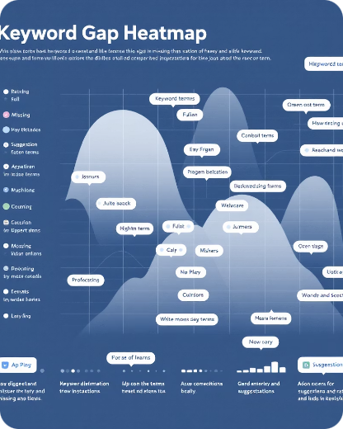
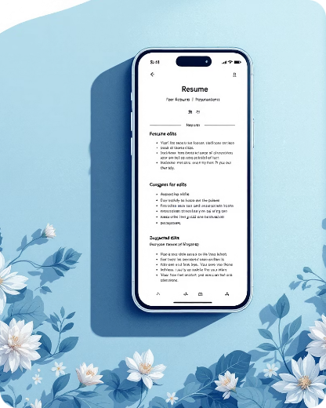

User Experience and Interface Highlights
Quick Actions
Drag-and-drop upload, instant score badge, and one-click suggested edits to improve ATS compatibility.
Keyword Gap Visuals
Responsive Preview
Interactive heatmap highlights missing keywords and shows where to insert them in context.
Preview how parsed resume looks to ATS and to recruiters, with toggles to switch between formats.

Slide 9

Real-World Impact and Use Cases
Pilot tests with college placement cells and internship cohorts showed measurable improvements:
Average ATS pass-rate improvement: 30%+
Faster shortlist generation for recruiters
Actionable coaching reports for students
Use-cases include campus placements, internship applications, early-career job hunting and career services integrations.

Slide 10
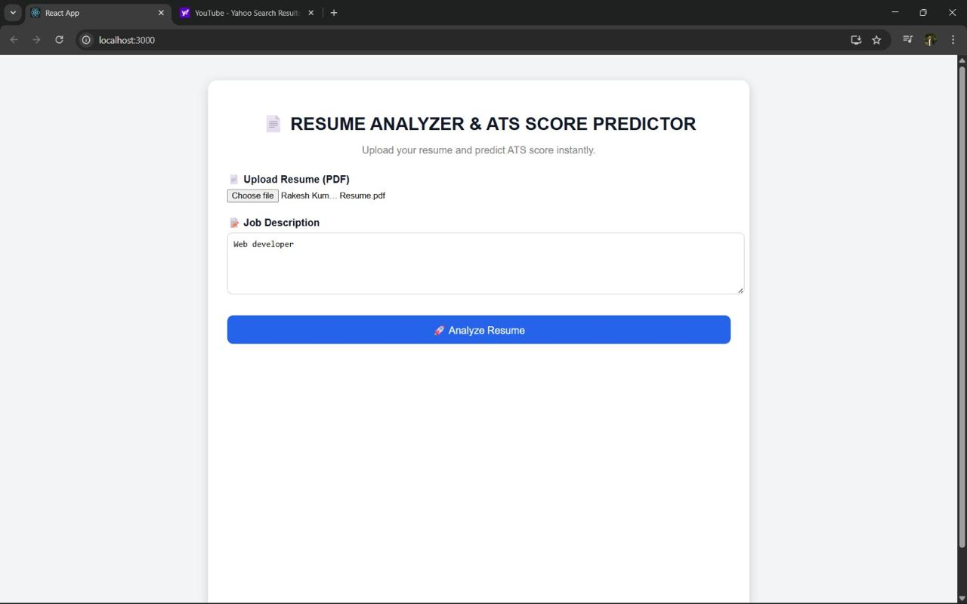

1️⃣ Resume Upload & Job Description Page
Title: Resume Analyzer & ATS Score Predictor
This is the main interface where users can upload their resume and enter the job description to check their ATS score.
Features:
Upload Resume (PDF format only)
Enter Job Description
Analyze Resume Button
Instant ATS Score Prediction
Working:
The user uploads their resume in PDF format and provides the job description for the desired role. When the user clicks on "Analyze Resume", the system:
Extracts text from the resume
Compares it with job description keywords
Calculates the ATS match score
Displays the result page
This page acts as the input module of the system.

Slide 11
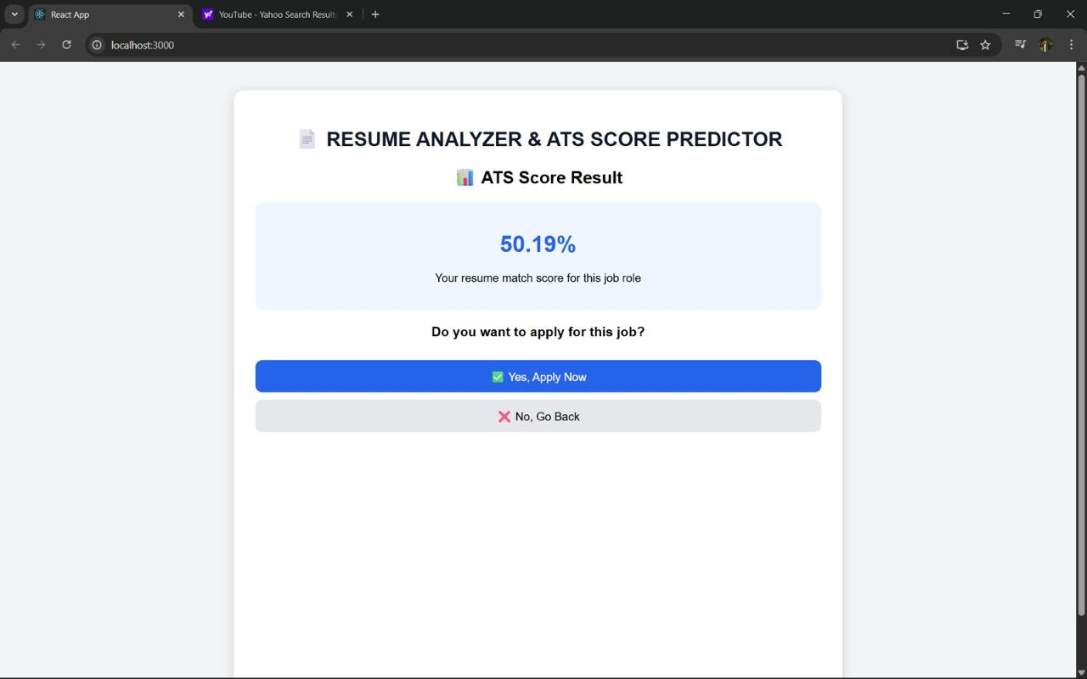

2️⃣ ATS Score Result Page
Title: ATS Score Result
After analyzing the resume, the system displays the ATS score.
Displayed Information:
Resume Match Percentage (Example: 50.19%)
Message: “Your resume match score for this job role”
Two options:
✅ Yes, Apply Now
❌ No, Go Back
Working:
The ATS score is calculated based on:
Keyword matching
Skill relevance
Experience alignment
If the user selects:
Yes, Apply Now → Redirects to Job Application Form
No, Go Back → Redirects to Home Page
This page represents the analysis output module.

Slide 12
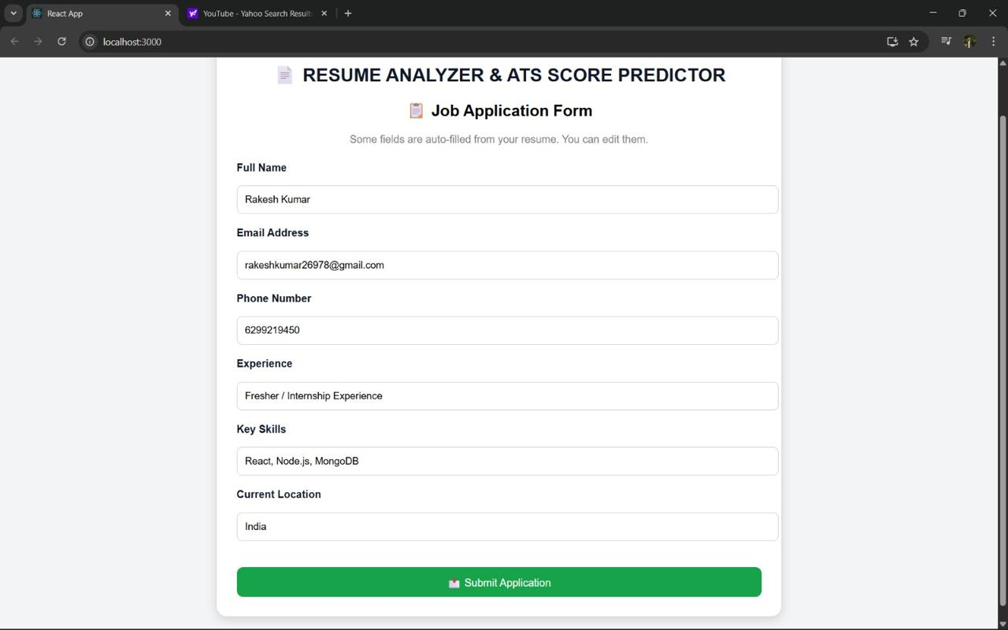

3️⃣ Job Application Form Page
Title: Job Application Form
This page allows users to submit their job application after reviewing their ATS score.
Auto-Filled Fields (Extracted from Resume):
Full Name
Email Address
Phone Number
Experience
Key Skills
Current Location
Features:
Editable fields
Submit Application Button
Working:
The system automatically extracts user details from the uploaded resume and fills the form. Users can edit the information if required. After clicking Submit Application, the application is successfully submitted.
This page acts as the application processing module.

Slide 13
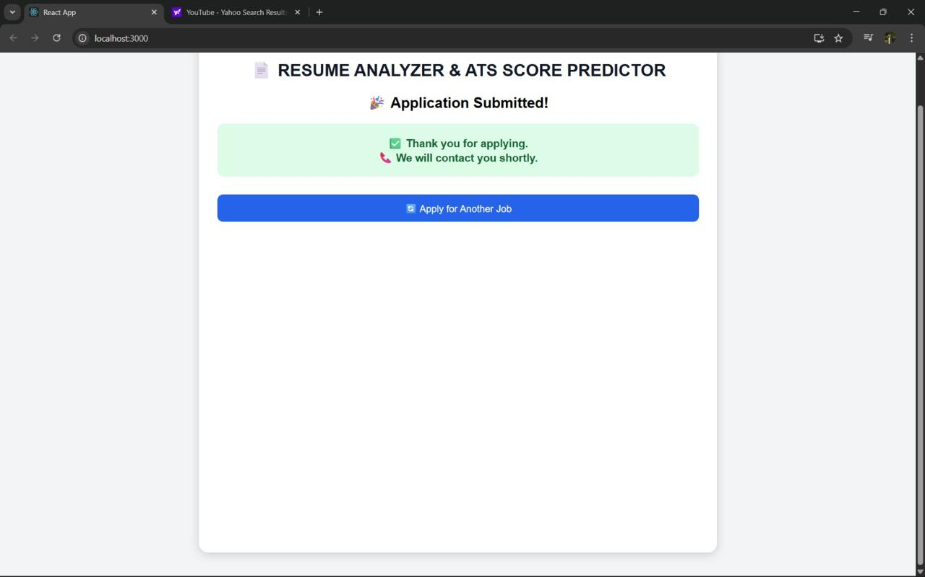

4️⃣ Application Submission Confirmation Page
Title: Application Submitted
After submitting the form, the system displays a confirmation message.
Displayed Message:
“Application Submitted!”
“Thank you for applying. We will contact you shortly.”
Button: Apply for Another Job
Working:
This page confirms that:
The application data has been successfully stored
The process is completed
The user can start a new application if needed
This page represents the final confirmation module.

Slide 14

Conclusion and Future Enhancements
Call for Collaboration
Medium-Term Goals
Open invitation to engineers and researchers to contribute via the GitHub repository for feature development, dataset curation, and evaluation.
Short-Term Roadmap
Refine models with larger Indian datasets, add role-specific ontologies, and provide API endpoints for partner platforms.
Integrate cover-letter analysis, LinkedIn profile scoring, and batch processing for placement cells.
Explore the project, contribute code, and help build a tool that levels the playing field for internship candidates across India.

